Slide 1
Compiler
Types of the Compiler:
Single pass
Two pass
Multiple pass

Slide 2
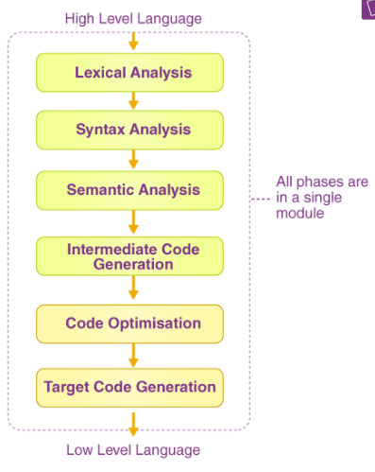

Compiler
Types of the Compiler:
Single pass
When we merge all the phases
of compiler design in a single module,
then it is called a single pass compiler.
In the case of a single pass compiler,
the source code converts into
machine code.

Slide 3

Compiler
Types of the Compiler:
2) Two pass
A processor that runs through the program to be translated twice is considered a two-pass compiler.

Slide 4
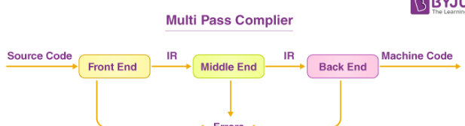
Compiler
Types of the Compiler:
3) Multiple pass
A program source code is processed many times by the multipass compiler. It breaks down a huge program into numerous smaller programs and runs them all at the same time.

